Slide 1



New Year ReFresh
777ggf
Brooklyn Infocommons
January 16 2021
Exp 07/21

Slide 2

Overview
Intro
Special Guest- Rose
New Years ReFresh
Outro
(Cypurr After Hours)

Slide 3
Who Are we?
We are…
The Cypurr Collective: A group of folks that organize cybersecurity events, looking to spread knowledge and talk about privacy rights!
Established April 2016
Just some folks interested in making safer spaces for others to talk bout their privacy needs

Slide 4
A Few Rules for the Space
Saf(er) Space - We DO NOT tolerate language or behavior purposefully meant to demean or harm folks based on their identities
Share the space - Feel free to ask questions in the chat! Or, save them for the Q/A!
Stack! - If we’re asking for vocal discussion, please use the “hand” icon to let us know you’re interested in speaking b4 you unmute!

Slide 5
A Few Rules for the Space
Photo/Video - Slides/Resources available after! Video available soon.
A note on voice recording…
We are trying to keep these presentations for posterity, and not to record participants. We will try to anonymize people when possible but please be aware that we are recording and may need to keep voices in the audio for context. Use the chat if possible for questions and discussions if you do not want your voice on the recording.

Slide 6
And now…

Slide 7
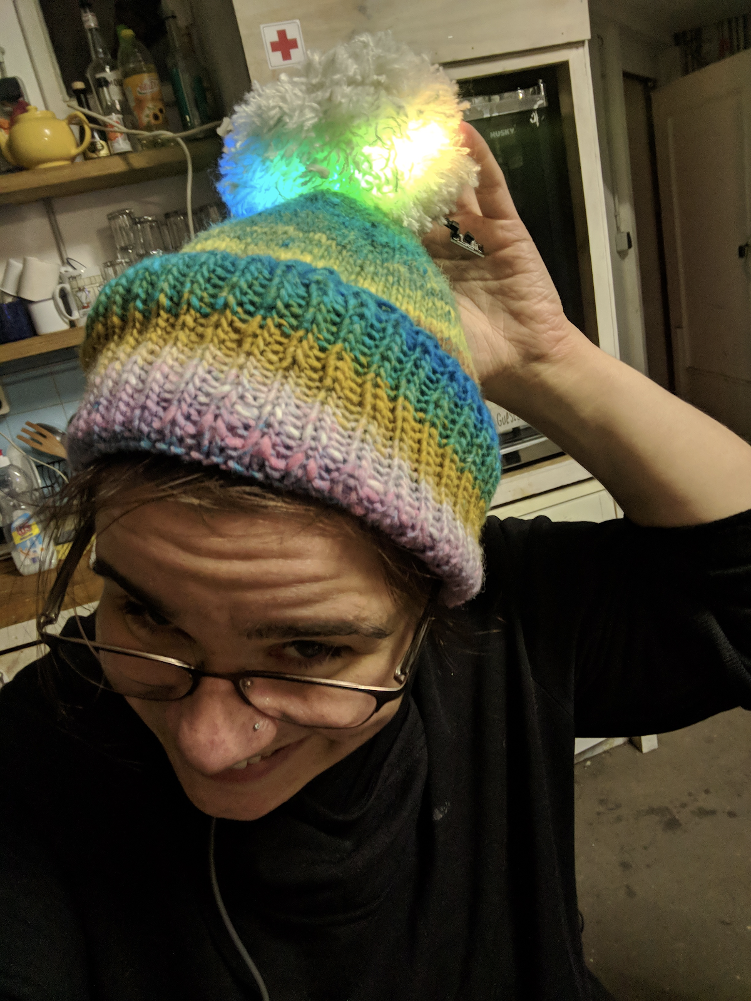
Rose
Regina Lawrence
Security researcher with New Design Congress. Since 2011, she has focused on issues of surveillance and digital security for activists, journalists, lawyers, and other human rights defenders. Her experience includes supporting both independent human rights advocates and organisations, such as Mozilla, Software Freedom Law Center, and Tactical Tech, as their Digital Security Coordinator.

Slide 8


Slide 9
Data = new oil

Slide 10

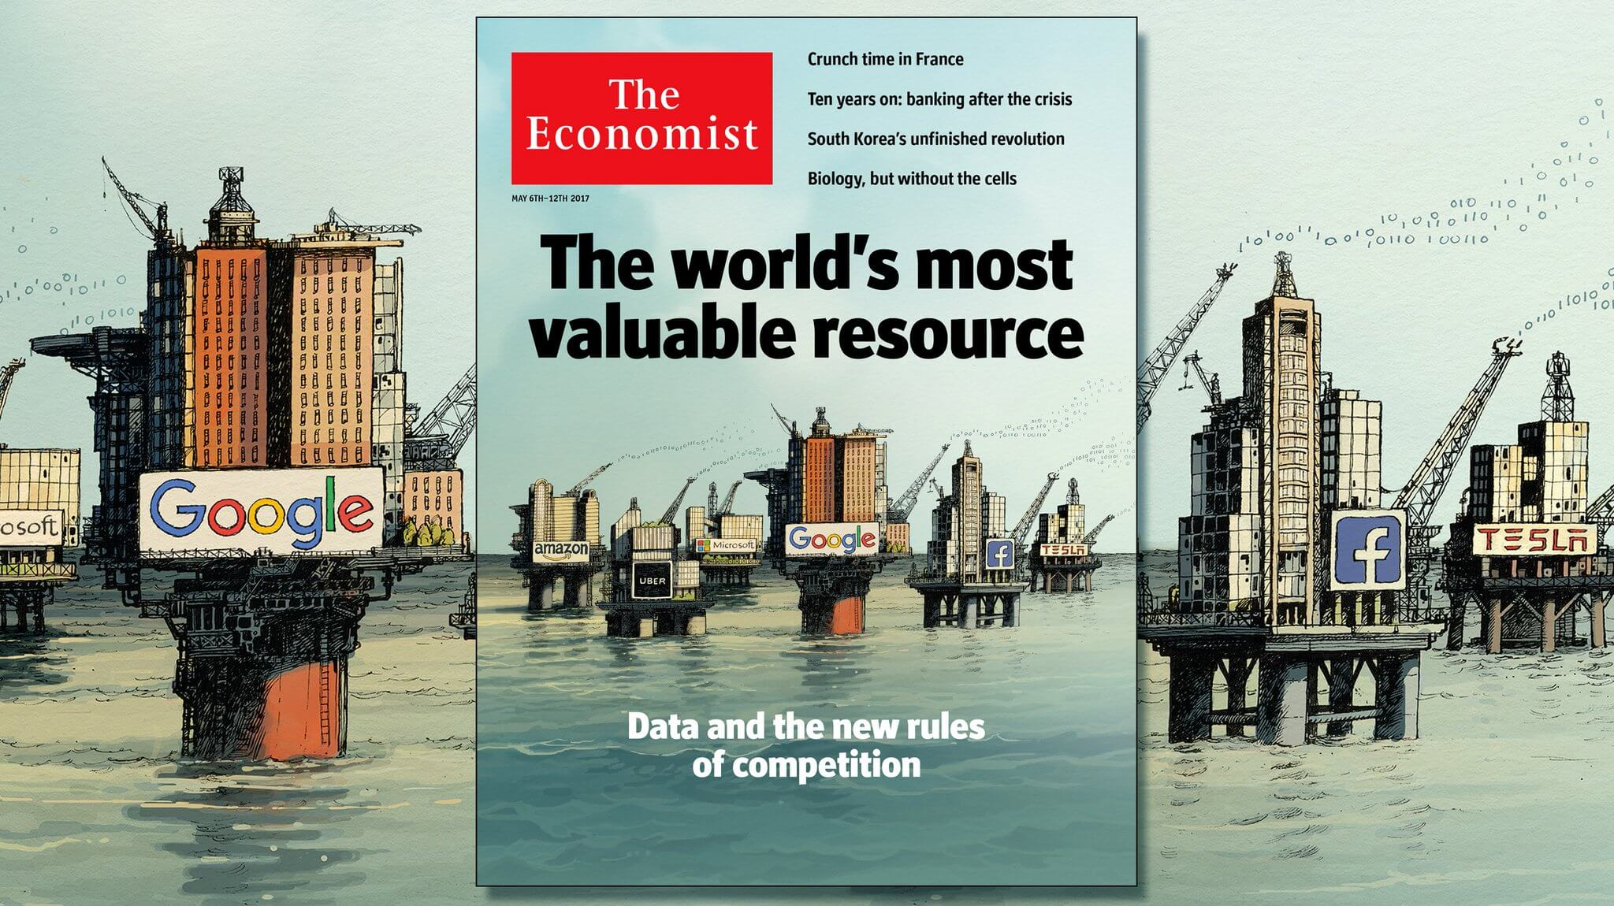
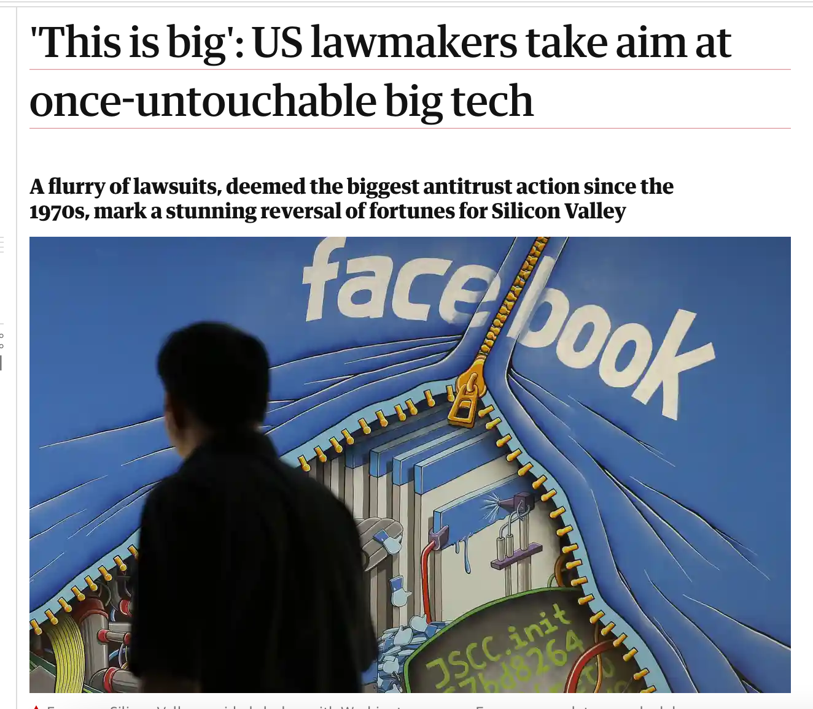
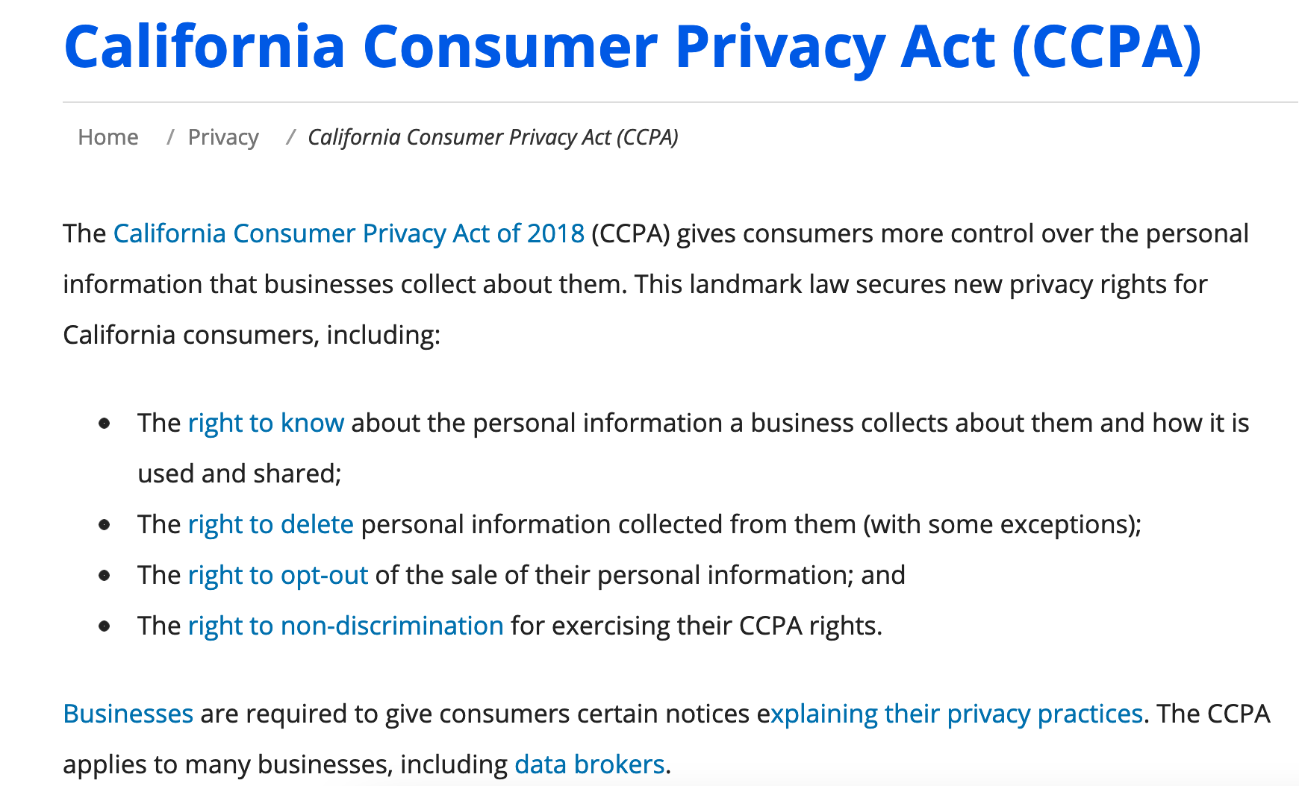
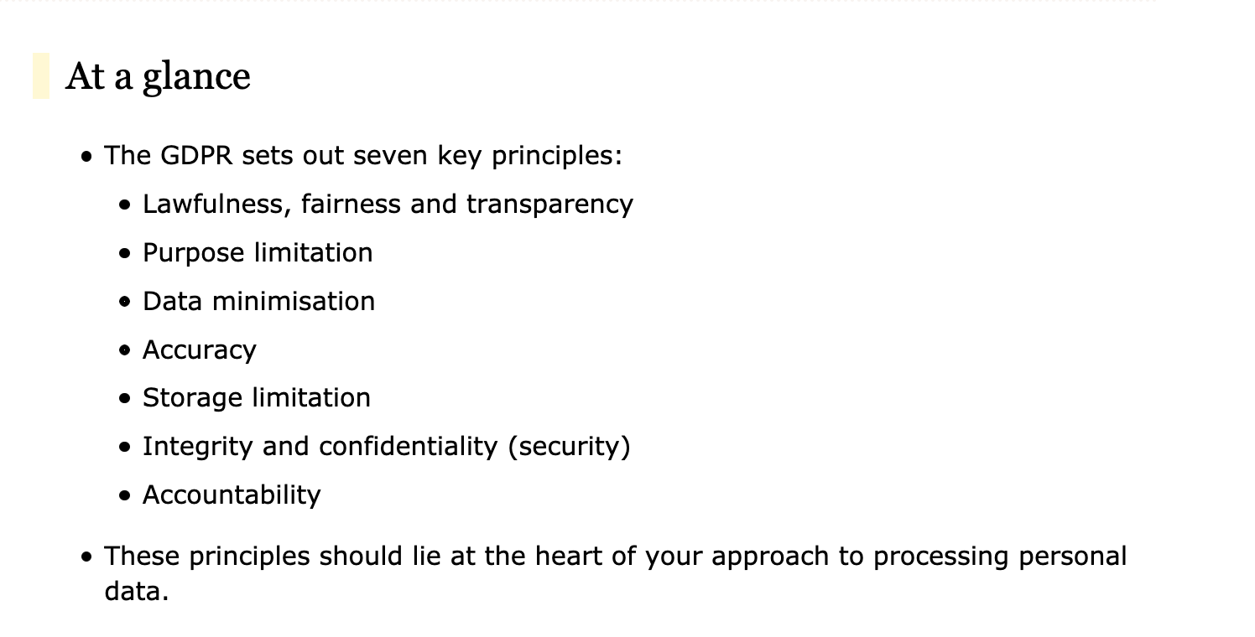
Data = new oil

Slide 11
Threat Model
Or why does it matter to you?

Slide 12
Threat Model
Or why does it matter to you?
What data do you have?

Slide 13

A Story of You
You and your Data

Slide 14

A Story of You
You and your Data
Who- Who are you? Who you know? Who are you connected to? Who you think you are? Who others think you are?
What- What do you do? What do you like? What are your hobbies? What do you do for your free time?
When- When were you born? What generation are you? When do you wake up? When do you go to work? When do you go online?
Where- Where do you live? Where do you work? Where do you exercise? Where do you shop? Where do you search?
How- How do you communicate? How do you make decisions? How do you learn? How do you shop?

Slide 15
A Story of You
WHY?
DO YOU DO THINGS?
WHY DO THEY WANT TO KNOW?
You and your Data

Slide 16
Threat Model
Or why does it matter to you?
What data do you have?
Who wants it?

Slide 17
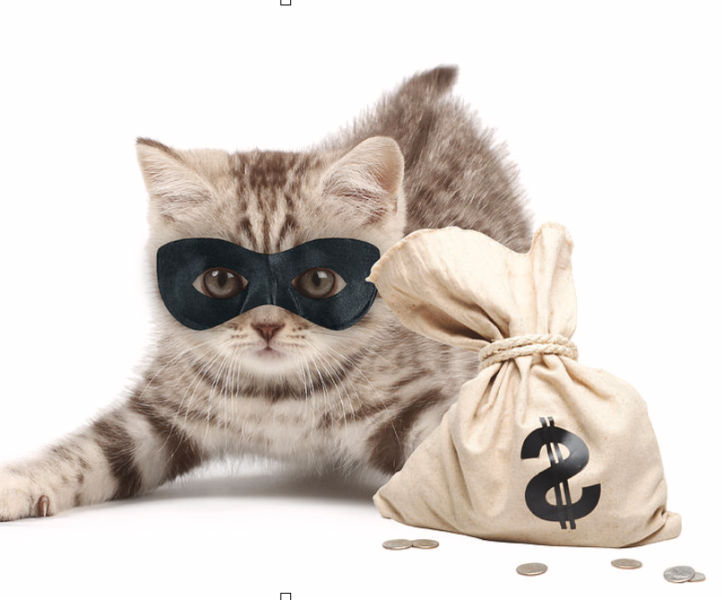
WHO WANTS IT?
CORPORATIONS
OTHER PEOPLE
STATE ENTITIES

Slide 18
Threat Model
Or why does it matter to you?
What data do you have?
Who wants it?
Are they getting it? How are they getting it?

Slide 19
How do we Know?
Are they really targeting me?
Apps
Phones
Smart Homes/IOT
Searches
Page Visits
Purchases
Travel
Socializing
Physical Geography
Ideology

Slide 20
How do we Know?
Are they really targeting me?
Apps
Phones
Smart Homes/IOT
Searches
Page Visits
Purchases
Travel
Socializing
Physical Geography
Ideology
Data In

Slide 21
How do we Know?
Are they really targeting me?
Apps
Phones
Smart Homes/IOT
Searches
Page Visits
Purchases
Travel
Socializing
Physical Geography
Ideology
Data Organized
Data In

Slide 22
How do we Know?
Are they really targeting me?
Ads
Interactions
Design
Suggestions
Motivations
Unknown use but we know it’s being collected
Apps
Phones
Smart Homes/IOT
Searches
Page Visits
Purchases
Travel
Socializing
Physical Geography
Ideology
Data Organized
Data Out
Data In

Slide 23
Threat Model
Or why does it matter to you?
What data do you have?
Who wants it?
Are they getting it? How are they getting it?
Personal Inventory

Slide 24
Threat Model
Or why does it matter to you?
What data do you have?
Who wants it?
Are they getting it? How are they getting it?
Personal Inventory
Is it a big deal
(to us? to me)?

Slide 25
Threat Model
Or why does it matter to you?
What data do you have?
Who wants it?
Are they getting it? How are they getting it?
Personal Inventory
Is it a big deal
(to us? to me)?
What am I willing to do to prevent this?

Slide 26
Data
Awareness
(Today)

Slide 27
Data
Awareness
(Today)
Prevention
(Part 2 coming July 2021)

Slide 28

Some tips…

Slide 29

Scrutinize
Free Isn’t Free
Privacy Policy/Terms of Use- Does the company respect your privacy?
Ethics of Company- Are they profiteers or are they concerned about their users?
Open Source- Is the code open for audit? Is there transparency?

Slide 30
Scrutinize
Privacy Policy/Terms of Use
Does the company respect your privacy?
Free Isn’t Free
What is Collected
Information you provide
Usage
Device Information
How it’s Stored
Encrypted?
Access?
When accessed?
How it’s Shared
Does it get sold?
To whom?
How are these entities vetted?

Slide 31

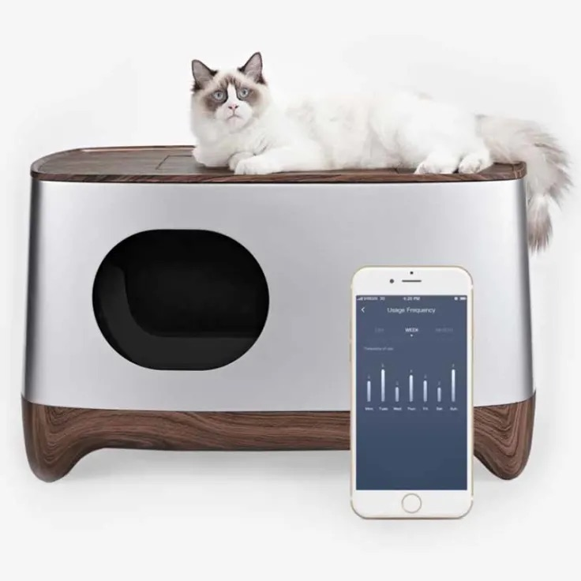
Scrutinize
Free Isn’t Free
Ethics of Company- Are they profiteers or are they concerned about their users?
*privacy not included (Mozilla)
Ikuddle Auto Pack Litter Box
No Privacy Policy
Will you receive it?

Slide 32

Scrutinize
Free Isn’t Free
Open Source- Is the code open for audit? Is there transparency?

Slide 33

Alternatives
Pros
Lists privacy-minded apps
Cons
Convenience

Slide 34
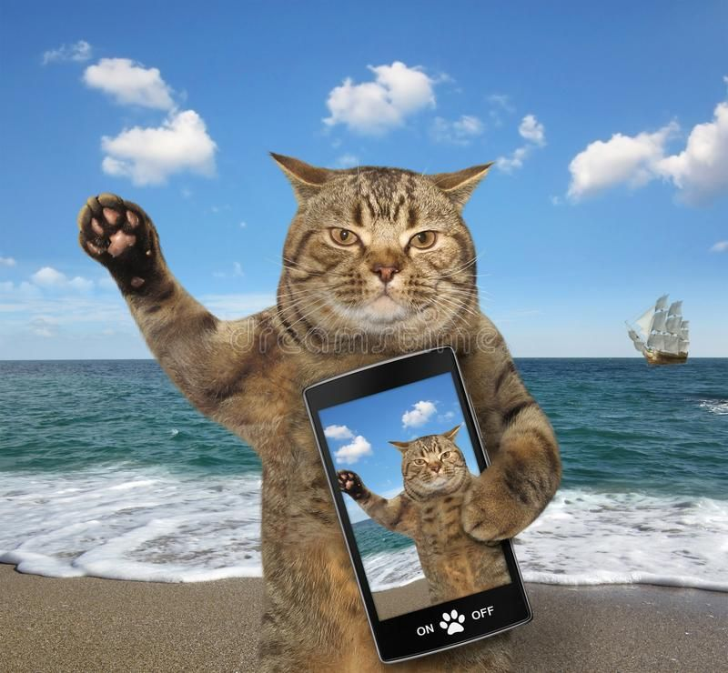
Phones
Tidying Up

Slide 35
Phones
Tidying Up
Do you need all that app clutter?- What apps am I using? What apps take up space?

Slide 36
Phones
Tidying Up
Do you need all that app clutter?- What apps am I using? What apps take up space?
Does your phone identify you?- Do you use your name for your phone/wifi/bluetooth?

Slide 37
Phones
Tidying Up
Do you need all that app clutter?- What apps am I using? What apps take up space?
Does your phone identify you?- Do you use your name for your phone/wifi/bluetooth?
What services run in the background?- Do you NEED wifi/bluetooth on all the time?

Slide 38
Phones
Tidying Up
Do you need all that app clutter?- What apps am I using? What apps take up space?
Does your phone identify you?- Do you use your name for your phone/wifi/bluetooth?
What services run in the background?- Do you NEED wifi/bluetooth on all the time?
Start from Scratch?- Factory Reset?

Slide 39
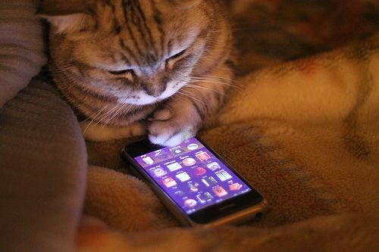
Apps
Tidying Up
Permissions- What are you allowing the app to access?
Location
Photos
Contacts
Camera
Keyboard
Media

Slide 40
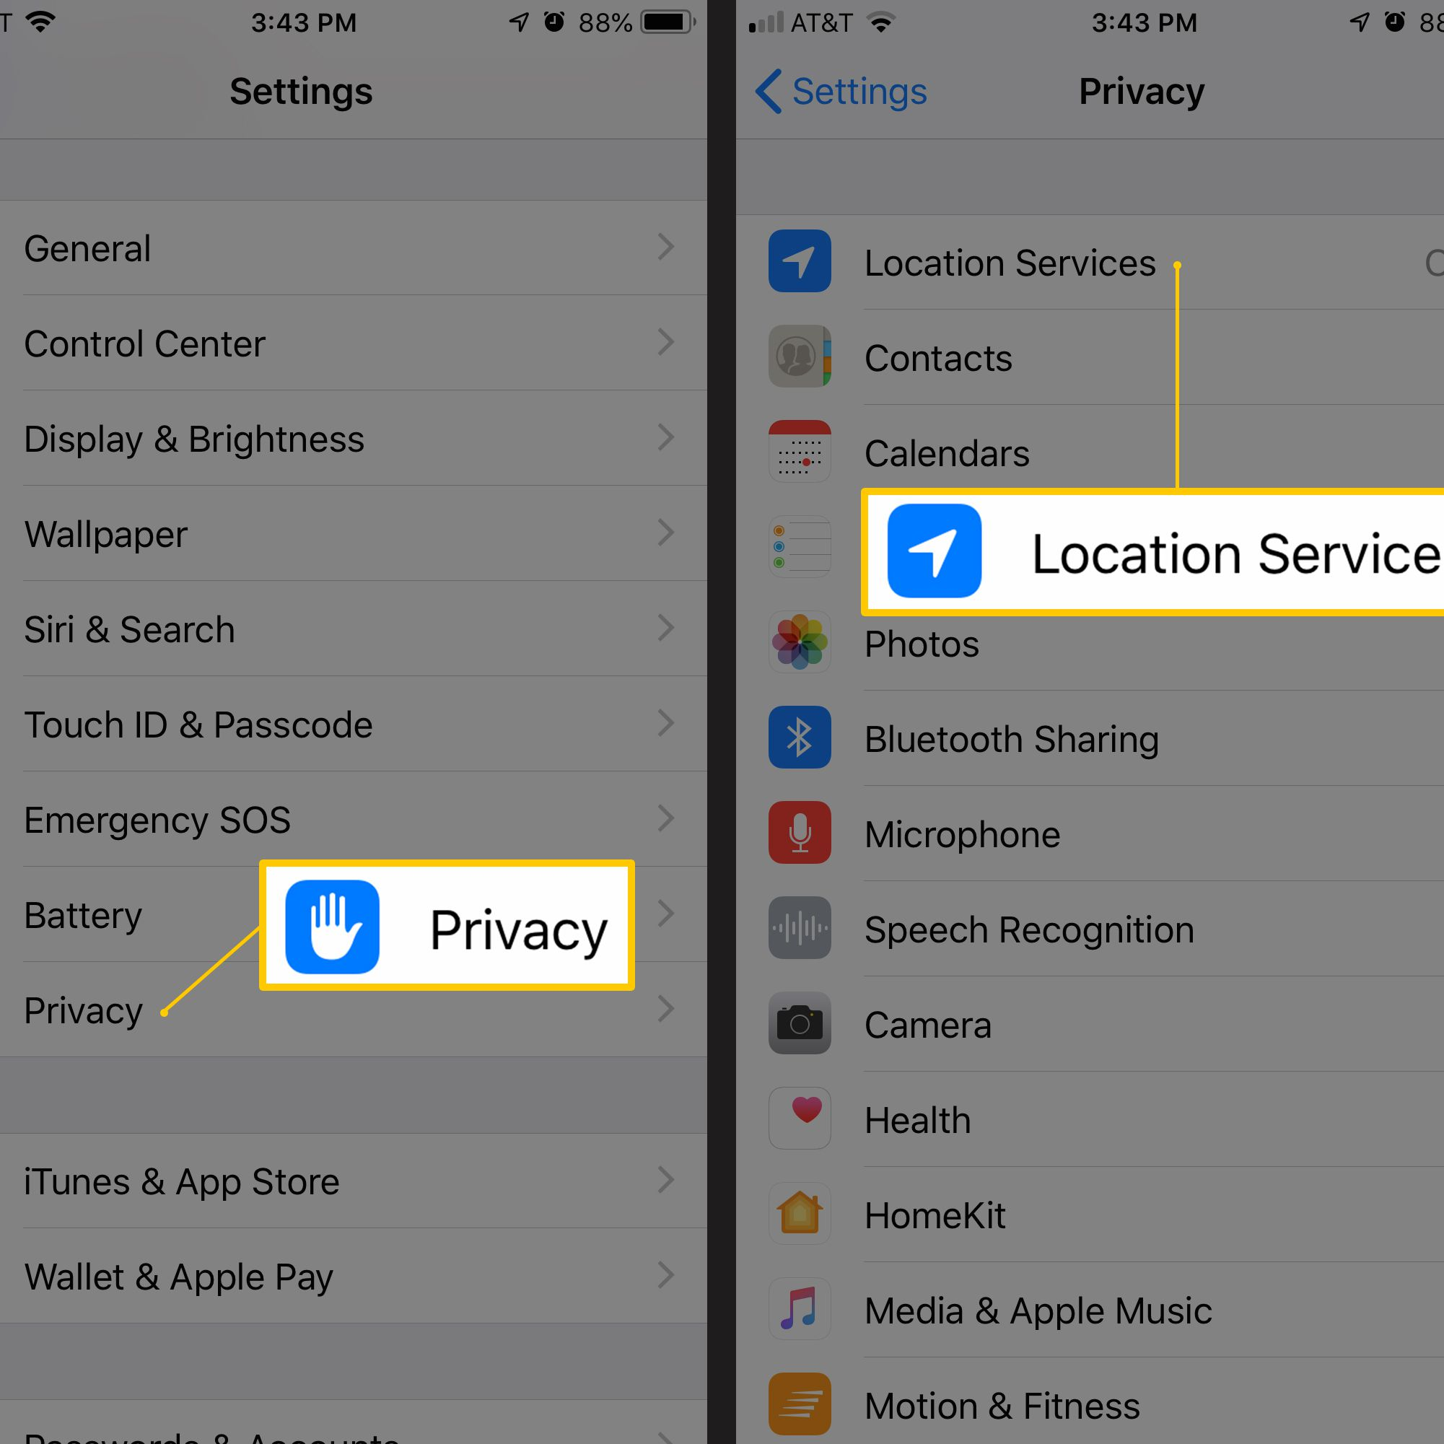
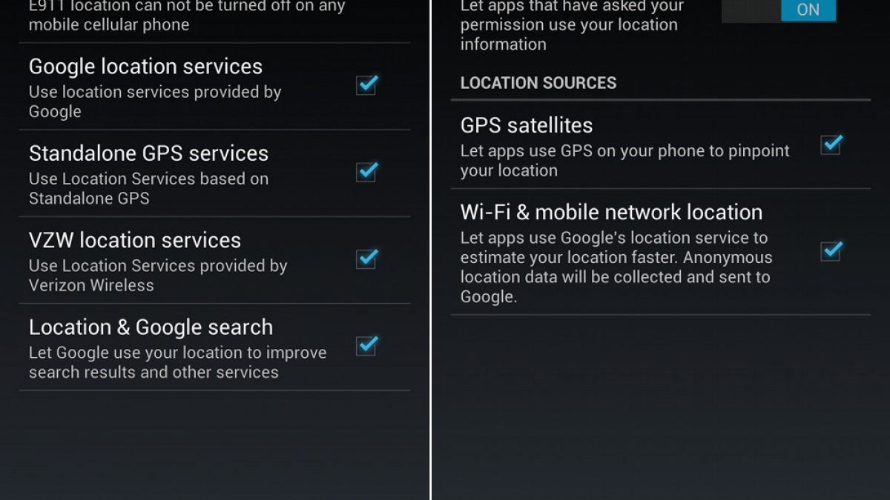
Location
Is the app actively keeping track of you?

Slide 41
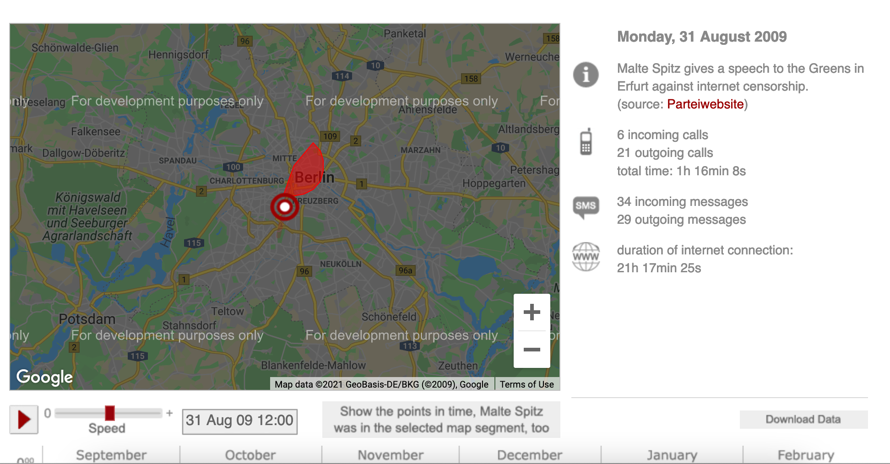
Green party politician Malte Spitz sued to have German telecoms giant Deutsche Telekom hand over six months of his phone data that he then made available to ZEIT ONLINE. We combined this geolocation data with information relating to his life as a politician, such as Twitter feeds, blog entries and websites, all of which is all freely available on the internet.
By pushing the play button, you will set off on a trip through Malte Spitz's life. The speed controller allows you to adjust how fast you travel, the pause button will let you stop at interesting points. In addition, a calendar at the bottom shows when he was in a particular location and can be used to jump to a specific time period. Each column corresponds to one day.

Slide 42
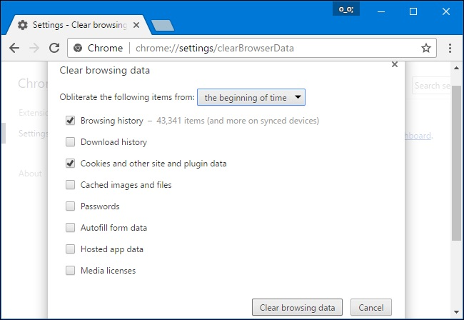
Browsers
Too many cookies
History/Cache/Cookies- What does your browser say about you?

Slide 43
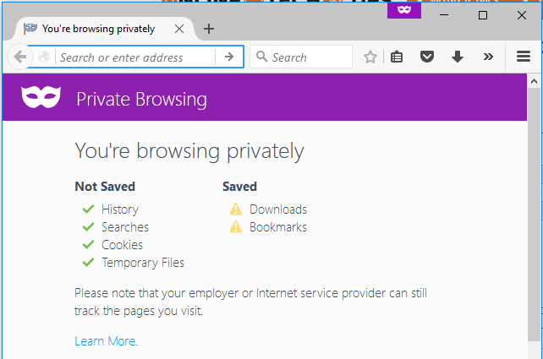
Browsers
Too many cookies
History/Cache/Cookies- What does your browser say about you?
Privacy Mode
Ex.
Incognito Mode (Chrome)
Privacy Mode (Firefox)

Slide 44

Social Media
ooph….

Slide 45
Social Media
ooph….
Settings- Does everyone need to know you like that? What privacy options does the company offer?

Slide 46
Social Media
ooph….
Settings- Does everyone need to know you like that? What privacy options does the company offer?
RSVP?- Do you NEED to RSVP to events?

Slide 47
Social Media
ooph….
Settings- Does everyone need to know you like that? What privacy options does the company offer?
RSVP?- Do you NEED to RSVP to events?
Tags- Do you NEED to be tagged?

Slide 48
Social Media
ooph….
Settings- Does everyone need to know you like that? What privacy options does the company offer?
RSVP?- Do you NEED to RSVP to events?
Tags- Do you NEED to be tagged?
Past Posts- Do you NEED all your posts?

Slide 49
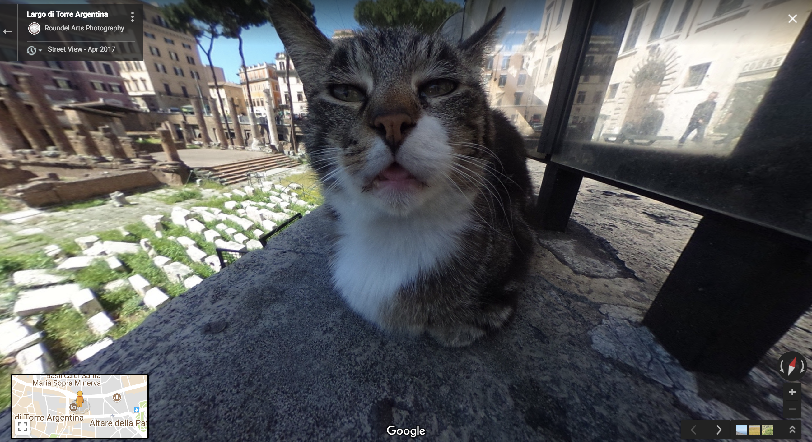
Online Search
What’s out there…?
Google yourself!

Slide 50
Online Search
What’s out there…?
Google yourself!
Internally-
Location Information
Searches

Slide 51
Online Search
What’s out there…?
Google yourself!
Internally-
Location Information
Searches
Externally
Old Profiles?
Images
People Finder?

Slide 52
Online Search
What’s out there…?
Google yourself!
Internally-
Location Information
Searches
Externally
Old Profiles?
Images
People Finder?
Resource Tip:
Check out Privacy Duck!

Slide 53
Detox Summary
Your data is valuable (probably because your valuable)
Threat Model to take inventory- you know your needs and situation best!
App Consciousness- think about WHY you need an app, think about what the app needs from you
Digital Hiegiene- No worries if you make mistakes, the best strategy is to do this frequently

Slide 54
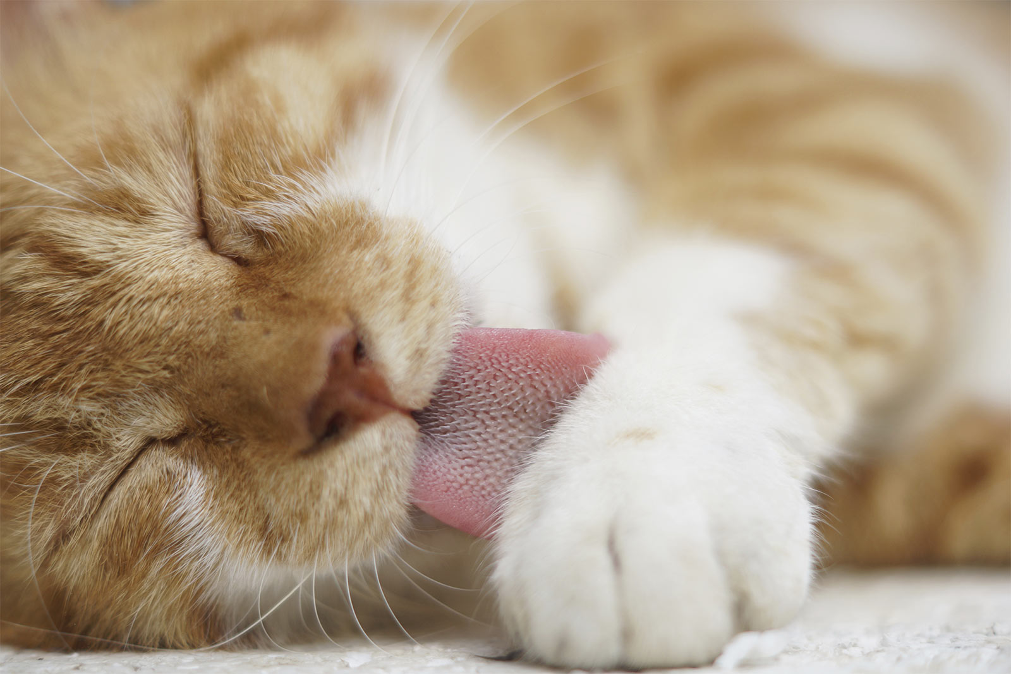
GO FORTH AND DETOX!
Thanks for watching!

Slide 55

Further Resources
Cypurr Resources
Website- https://cypurr.nyc
Open Collective (Donation/Tshirt)- https://opencollective.com/cypurr-collective
Quesions? Comments? Topic Ideas?
Email- cypurr@protonmail.com
Join our email list for updates!
Social Media- FB/Twtitter @cypurrnyc

